Slide 1
CSE 474 QA
Configuration Management
W. Clements

Slide 2
5. QA Processes
(V&V, Reviews, Audits)
8. Reviews & Audits
(Tech, Mngt., Inspection, walk-throughs, checklist)
10. Configuration Management
1. Fundamentals & Business Case for Quality Assurance
(IEEE SWBok)
9. Maturity
(CMM, Process, Product, ISO)
11. Risk/Mission Assurance
(Training, CAR, Mitigation)
6. QA Tools
(Fishbone, check, Histograms, Pareto, Scatter, Stratification)]
12. Security/ Legal/ Ethics
(Regulations, Code, Legal, Safety)
2. QA’s Role in SW Lifecycle, Methodologies,
Architecture
[Responsibilities & Roles]
7. QA Attributes
(Verification and Validation )
13 . Project Management
(CoQ, WBS, DevOps )
[VDD, Version, DM, DI]
14. Careers Path
3. QA Techniques
(Dyn, Static, and Testing)
[]
4. Quality Metrics
(Characteristic & Models)
[Measuring]
Know
Do
Become
SWE 474: Quality Assurance Class

Slide 3
Overview
Review
Assignments
Reading
What is involved in the Configuration Infrastructure?
How do you audit Configuration Management?
Complete SQAP Section 10 and 12
CM
Case Studies

Slide 4
Reading
E. Bersoff, "Elements of software configuration management," IEEE Trans. on Softw. Eng., vol. SE-10, no. 1, pp. 79-87, Jan. 1984, (page 9) [Online] Available: http://ieeexplore.ieee.org/stamp/stamp.jsp?tp=&arnumber=5010202&isnumber=5010187
12207-2008 - ISO/IEC/IEEE International Standard - Systems and software engineering -- Software life cycle processes
https://ieeexplore-ieee-org.byui.idm.oclc.org/document/6042287
Section 7.2.2: Software Configuration Management Process (pg 82 – 83) (pages 2)
828-2005 - IEEE Standard for Software Configuration Management Plans
https://ieeexplore-ieee-org.byui.idm.oclc.org/document/1502775
SWEBOK: Chap 6: Software Configuration Management (page 118 -132) (pages 14)
https://www.computer.org/education/bodies-of-knowledge/software-engineering
L. Westfall Certified Software Quality Engineer Handbook, ASQ Quality Press, 2009-09-01, https://ebookcentral.proquest.com/lib/byui/detail.action?docID=3002591
Part VII (pages 78)
Chapter 26 A. Configuration Infrastructure
Chapter 27 B. Configuration Identification
Chapter 28 C. Configuration Control and Status
Chapter 29 D. Configuration Audits
Chapter 30 E. Product Release and Distribution

Slide 5
What is Configuration Infrastructure?
What is involved in the Configuration Infrastructure?
The Configuration Infrastructure usually consists of two main libraries to store configuration items: the software product library and the project documentation library.

Slide 6
What is Configuration Infrastructure? What is involved in the Configuration Infrastructure?
Software Product Library
Project Documentation Library
The first library consists of the software product, for the sake of this lesson we will call it the Software Library.
Software product configuration items include
code, software tools (scripts, the current version of CASE tools, etc.), unit tests, data, and built products.
File names for each software product are unique and typically don’t change without CCB review and approval; as such, version numbers are not included in configured file names.
However, the configuration item for a file is versioned and the version is tracked.
Typically intermittent products are not saved in the library; such as compiler files, temporary files, and anything that can be quickly produced by running a script. File’s will not contain commented-out code, as it will be stored in a previous version of the file and can be retrieved by the library software.
The second library consists of project documentation. It will be referred to as the Project Library for this lesson.
All project records must be saved, versioned, and tracked to provide evidence that the project team is completing the work items identified in the contract.
Basic documents which must be configured are project policies, plans, and procedures. Other required documents include the meeting records (minutes, reviews, action items, and audits) and development results (software development folders and tests results).
More advanced items include change requests, actions items, corrective reports, logs, checklists, and completed forms (purchasing, travel, approval, etc.).

Slide 7
What is involved in the Configuration Infrastructure?
Step 1: Identify CMM Configuration Items
You will need to identify at least 20-30 items found in last each levels 2-5. week’s CMM activities. You will need to have at least 5-10 for
Step 2: Categorize Configuration Items
Your project has identified the following items in addition to the items found in CMM Key Practices. Organize all the items into categories. Identify where each of the types of Configuration Items should be located
Step 3: Software Library vs Project Library
From the list above create a two libraries infrastructure, the Software Library and Project Library. You will need to come up with the subdirectory for each, but here are the main categories

Slide 8
What is Configuration Infrastructure? What is a configuration item?
A configuration item (CI) is any item produced during product development.
Better defined as any item, code, data, or document produced by the project team; anything used to develop the product; any biproducts of product development.
Each CI has a unique identifier, typically an alphanumeric string representing its purpose, version, and use. Each CI is assigned to a role owner who is in charge of its changes.
Much like all products, CIs have a birth, a life span, and retirement.
This can be compared to the initialization, instancing, and then the archival or destruction of a code object. You might also relate it to a database item, which is added, lives in the database to be read and modified over time, and is eventually deleted.
Similarly, CIs must be created, stored, versioned, accessed, changed, and archived. Determining how and where to store a CI during its lifespan is essential.

Slide 9
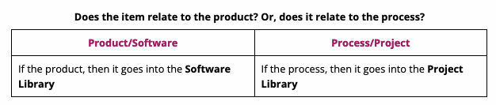
Managing Configuration Items
Here are some questions to ask about a software change or a project change which will help you determine how to track it in the CM System as a CI, and which library to store it in: either the Software Library or the Project Library

Slide 10
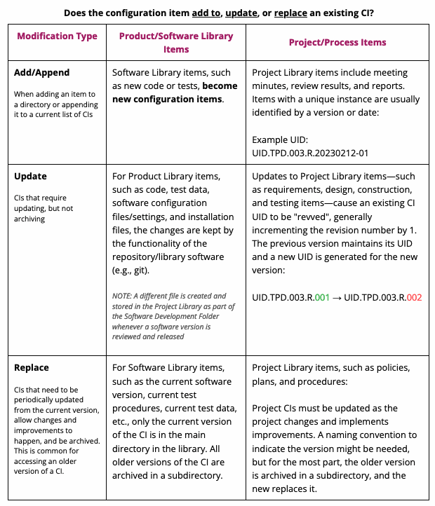

Slide 11
How does the Configuration Control Board work?
The Configuration Control Board is the governing authority for both libraries’ changes.
The CCB meets at least once a week or based on events to approve the Software Library and Project Library changes.
The CCB also authorizes individuals to approve charges based on pre-approved processes and document types, such as reviews, software development folders, code changes, tests results, and deliveries based on established plans, procedures, and meeting minutes.

Slide 12
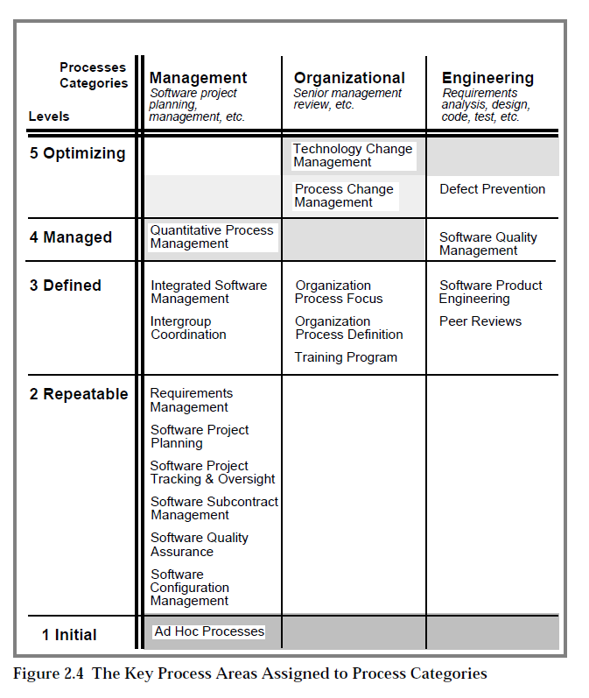
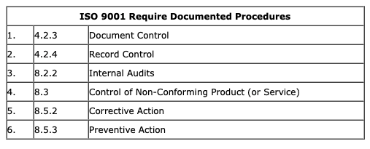
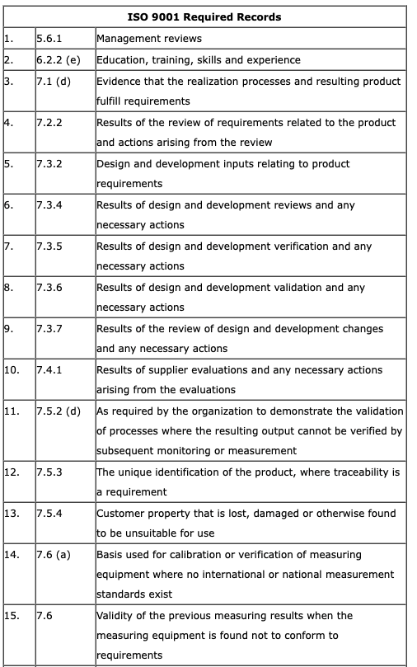
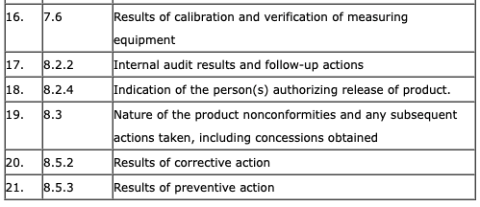
Part 1: Id CMM Configuration Items
dentify at least 30 items found in last week’s CMM activities. An item is a deliverable or product from a checkpoint, milestone, or meeting. Identify items by looking at CMM activities and determining their output.
To receive full credit for this step, do the following:
Identify at least 30 total items (CIs)
For each CMM level, identify a minimum of 5 items.
Some levels will need more than others to meet the required minimum of 30 items!
For each CMM level, have items from at least 2 Key Process Areas.
Use this technical report and start on page 91. Key process areas are the parents of CMM activities (e.g., Level 2 Software Project Planning: 15 activities, page L2-11)

Slide 13
Part 2: Categorize Configuration Items
Configuration Items
Software Development Plan
Software Requirements Specification
Rough order of magnitude.
Unit Test for Module A
Development plan for Module B
Integration Plan
Version Description Document
Architecture Design Document
Quality Assurance Plan
Detailed Design Specifications
3-Party library compiled code (.lib files) updated every 6 months
Compile Scripts
Integration Test Cases for Package X (Module A & B)
System Test Cases
Acceptance Test Cases
Installation Instructions
Deilvery package for Mobil App
User Manual
Delivery package for Windows App
Configuration Management Process: Approving lastest version
Configuration Management Process: Updating Configuration Management Plan
Delivery package for Linux App
Program Management Plan
Delivery package for Web Server
Software Testing Plan
Software Testing Process: Updating Software Testing Plan
Delivery package for Web Client
Software Engineering: Training Process and Approval
Delivery package for iOS App
Software Development Reviews of Unit A.1-A.6
Nightly compile scripts
Configuration Management Process: Modify controlled Work Product
Configuration Managmeent Procedure: Create new branch
Configuration Management Procedure: Merge branches
Configuration Management Policy: Baseline version/baseline scheme
Nightly automated test scripts
Software Development Reviews of Unit B.1-B.7
User Manual
Weekly project status meetings
Configuration Management Process: Create a Software Build
Weekly project planning meetings
Configuration Management Process: Approving updates from 3-party suppliers
Software Engineering: Traning Policy
Version Build Script
Configuration Management Process: Create a New SW Work Product
Configuration Management Policy: Configuraton Metrics and Data collection
Configuration Management Policy: Audits
Software Development Review checklist
Software Testing Review checklists
Program Management Schedule
Project Management Budget
Project Management: Cause, Analysis and Resolution
Project Management: IEEE Documentation
In addition to the items identified in Part 1, your project has identified the items listed below. Organize all the items from Part 1 into categories and sub-categories. In a separate library infrastructure, organize all the items below into categories and sub-categories. These will become your sub-directories in Part 3. Ensure each item is placed in an appropriate category.

Slide 14
Part 3: Organize the Library
Categories
Project Library
Program Management
System Engineering
Configuration Management
Software Development
Software Testing
Quality Assurance
Program Library
Source Code
Test Code
Test Data
Test Scripts
Delivery Scripts
Configuration Scripts
3partylibrary
3partySourceCode
Deliveries
Now that the CIs are sorted into categories and sub-categories, place them in their respective parent directory in either the Project Library or the Software Library. You may need to create additional directories to group everything logically.
In some cases, an item in the list above may need to be broken into pieces. For example, integration test cases may contain procedures (as code or documents), input data, comparison data, and results. Consider breaking some of the items above into their respective parts when adding them to the Software or Project libraries below:

Slide 15
CMM & ISO 9001:2015
CMM Level 2-5
What is ISO 9001?
minimum requirement for ISO 9001:2008 is a quality manual, six documented procedures (I call these support processes), and 21 records
http://www.pinnacleeg.com/iso/iso-9001-myth-2-say-what-you-do-do-what-you-say/

Slide 16
What is involved in the Configuration Infrastructure?
Configuration Items
Software Development Plan
Software Requirements Specification
Rough order of magnitude.
Unit Test for Module A
Development plan for Module B
Integration Plan
Version Description Document
Architecture Design Document
Quality Assurance Plan
Detailed Design Specifications
3-Party library compiled code (.lib files) updated every 6 months
Compile Scripts
Integration Test Cases for Package X (Module A & B)
System Test Cases
Acceptance Test Cases
Installation Instructions
Deilvery package for Mobil App
User Manual
Delivery package for Windows App
Configuration Management Process: Approving lastest version
Configuration Management Process: Updating Configuration Management Plan
Delivery package for Linux App
Program Management Plan
Delivery package for Web Server
Software Testing Plan
Software Testing Process: Updating Software Testing Plan
Delivery package for Web Client
Software Engineering: Training Process and Approval
Delivery package for iOS App
Software Development Reviews of Unit A.1-A.6
Nightly compile scripts
Configuration Management Process: Modify controlled Work Product
Configuration Managmeent Procedure: Create new branch
Configuration Management Procedure: Merge branches
Configuration Management Policy: Baseline version/baseline scheme
Nightly automated test scripts
Software Development Reviews of Unit B.1-B.7
User Manual
Weekly project status meetings
Configuration Management Process: Create a Software Build
Weekly project planning meetings
Configuration Management Process: Approving updates from 3-party suppliers
Software Engineering: Traning Policy
Version Build Script
Configuration Management Process: Create a New SW Work Product
Configuration Management Policy: Configuraton Metrics and Data collection
Configuration Management Policy: Audits
Software Development Review checklist
Software Testing Review checklists
Program Management Schedule
Project Management Budget
Project Management: Cause, Analysis and Resolution
Project Management: IEEE Documentation
Step 1: Identify CMM Configuration Items
You will need to identify at least 20-30 items found in last week’s CMM activities. You will need to have at least 5-10 for each levels 2-5.
Step 2: Categorize Configuration Items
Your project has identified the following items in addition to the items found in CMM Key Practices. Organize all the items into categories. Identify where each of the types of Configuration Items should be located
Step 3: Software Library vs Project Library
From the list above create a two libraries infrastructure, the Software Library and Project Library. You will need to come up with the subdirectory for each, but here are the main categories

Slide 17
What is involved in the Configuration Infrastructure?
Configuration Items
Software Development Plan
Software Requirements Specification
Rough order of magnitude.
Unit Test for Module A
Development plan for Module B
Integration Plan
Version Description Document
Architecture Design Document
Quality Assurance Plan
Detailed Design Specifications
3-Party library compiled code (.lib files) updated every 6 months
Compile Scripts
Integration Test Cases for Package X (Module A & B)
System Test Cases
Acceptance Test Cases
Installation Instructions
Deilvery package for Mobil App
User Manual
Delivery package for Windows App
Configuration Management Process: Approving lastest version
Configuration Management Process: Updating Configuration Management Plan
Delivery package for Linux App
Program Management Plan
Delivery package for Web Server
Software Testing Plan
Software Testing Process: Updating Software Testing Plan
Delivery package for Web Client
Software Engineering: Training Process and Approval
Delivery package for iOS App
Software Development Reviews of Unit A.1-A.6
Nightly compile scripts
Configuration Management Process: Modify controlled Work Product
Configuration Managmeent Procedure: Create new branch
Configuration Management Procedure: Merge branches
Configuration Management Policy: Baseline version/baseline scheme
Nightly automated test scripts
Software Development Reviews of Unit B.1-B.7
User Manual
Weekly project status meetings
Configuration Management Process: Create a Software Build
Weekly project planning meetings
Configuration Management Process: Approving updates from 3-party suppliers
Software Engineering: Traning Policy
Version Build Script
Configuration Management Process: Create a New SW Work Product
Configuration Management Policy: Configuraton Metrics and Data collection
Configuration Management Policy: Audits
Software Development Review checklist
Software Testing Review checklists
Program Management Schedule
Project Management Budget
Project Management: Cause, Analysis and Resolution
Project Management: IEEE Documentation
Step 1: Identify CMM Configuration Items
You will need to identify at least 20-30 items found in last week’s CMM activities. You will need to have at least 5-10 for each levels 2-5.
Step 2: Categorize Configuration Items
Your project has identified the following items in addition to the items found in CMM Key Practices. Organize all the items into categories. Identify where each of the types of Configuration Items should be located
Step 3: Software Library vs Project Library
From the list above create a two libraries infrastructure, the Software Library and Project Library. You will need to come up with the subdirectory for each, but here are the main categories
Categories
Project Library
Program Management
System Engineering
Configuration Management
Software Development
Software Testing
Quality Assurance
Program Library
Source Code
Test Code
Test Data
Test Scripts
Delivery Scripts
Configuration Scripts
3partylibrary
3partySourceCode
Deliveries

Slide 18
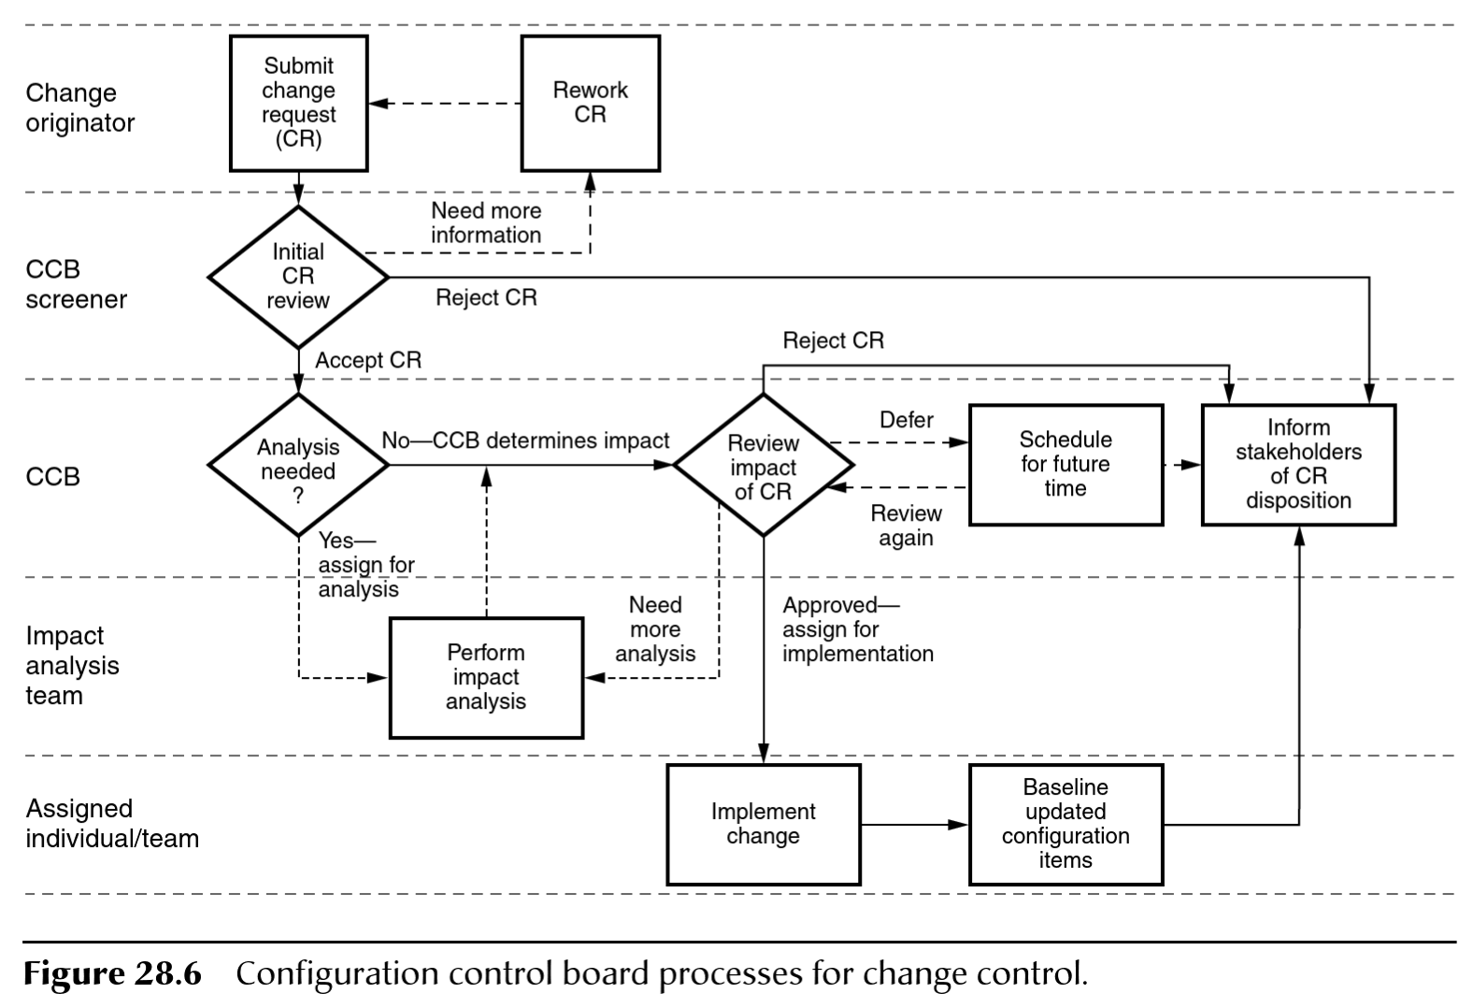
How do you audit Configuration Management?
Step 1: Compare and Contrast
Compare and Contrast the CCB processes from the Quality Engineer Handbook (Figure 28.6) and the SWEBoK (Figure 6.3). Select each image to load the associated reading. Summarize each process.

Slide 19
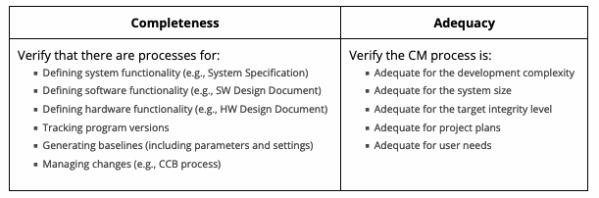
How do you audit Configuration Management? Part 2: CM Audit Checklist
Step 1: Create an Audit Checklist
Create an audit checklist for auditing the CM Library you built in the previous assignment. The checklist should look for CIs that satisfy the following criteria:
In building your checklist, include information you learned in Module 09: CMM. The audit checklist must have a minimum of 5-6 checklist items for Completeness and for Adequacy, for a total of 10-12 checklist items to use in your audit.
Each checklist item should have at least three levels of compliance. For example, a stoplight chart may be used to show high compliance (green), medium compliance (yellow), or low compliance (red)

Slide 20
How do you audit Configuration Management? Part 2: CM Audit Checklist
Step 2
Perform a self-audit on your library from the previous Teach One Another Assignent. You should be looking to see if you have all the CIs required to satisfy the criteria of the checklist. Find at least one issue with your library (hierarchy; missing CIs) and provide suggestions on what could be improved.

Slide 21
How do you audit Configuration Management? Part 2: CM Audit Checklist
Step 3
Perform an audit of another team's library using their checklist. Find at least one issue with the library and report your findings to the other team.
Using your experience of performing an audit with another team's checklist, identify two things your team can do to improve your own audit checklist. This could be something you missed in your self-audit or in your audit of the other team.

Slide 22
How do you audit Configuration Management? Part 2: CM Audit Checklist
Step 4
Have another group review your library using their checklist. Ensure they identify at least one issue and report back to you. Record their findings and write a resolution plan to address the issue.

Slide 23
How do you audit Configuration Management?
Create an audit checklist based on the IEEE Configuration Management Assessment. Include information you learned last week from CMM. The checklist must contain a list of 5-6 for Completeness and Adequacy. Each checklist should have at least three (for example stop light: green. Yellow, red) level of compliance.
(1) Configuration Management Assessment Verify that the configuration management process is complete and adequate. The task criteria are as follows: a) Completeness Verify that there is a process for describing the system, software, and hardware product functionality, tracking program versions, generating baselines (including parameters and settings), and managing changes. b) Adequacy Verify that the configuration management process is adequate for the development complexity, system size, integrity level, project plans, and user needs.
Perform a self audit on the previous Teach One Another.
Find one issue that can be improved in your library or CCB process.
Provide improvement suggestion for the library or CCB process.
Obtain another team’s checklist and perform a self-audit.
Find one issue with the Library or CCB.
Identify two things that your team can improve your audit.
Have another group review your Library and CCB using their checklist.
Identify one issue and put in a resolution plan to fix it.

Slide 24
Complete SQAP Section 10 and 12
4.10 Media control (section 10 of the SQAP)
4.12 Records collection, maintenance, and retention (section 12 of the SQAP)
Using what you have learned from the Teach activities, update the SQAP sections 10 and 12, and learn about CCB, Project, and Product Library. Media include all software that is being used (software), data that is being stored (testing), and delivered software products (deliverables). This section should also include security and references to SCMP. The SCMP is not part of this course and will be referenced in this section.
4.10 Media control (section 10 of the SQAP) This section shall state the methods and facilities to be used to a) Identify the media for each intermediate and deliverable computer work product and the documentation required to store the media, including the copy and restore process. b) Protect computer program physical media from unauthorized access or inadvertent damage or degradation during all phases of the software life cycle. This may be provided as a part of the SCMP. If so, an appropriate reference shall be made to it.
You will need to make sure that you have included section/subsection descriptions for each. You will need to include at least two subsections, each for part A and B for 4.10 Media Control.
Part A has a particle implication of licensing, delivery, version control, and backup policies.
Part B implies physical and electronic security. If you decide to reference the SCMP you will have to also provide a separate document that is the SCMP.
Section 4.12 of IEEE 730-2002 (Section 12 of the SQAP) contains information that is generated from the process of producing a software product. Evidence shows that procedures are being followed, milestones are being reached, and reviews and audits are being done.
4.12 Records collection, maintenance, and retention (section 12 of the SQAP) This section shall identify the SQA documentation to be retained, shall state the methods and facilities to be used to assemble, file, safeguard, and maintain this documentation, and shall designate the retention period. Section 12: Records collection, maintenance, and retention Section 12.1 Records collection Section 12.2 Record maintenance Section 12.3 Record retention
You will need to provide section/subsection descriptions, and also address the difference between product and project records. Use this week’s activities to supplement this section.

Slide 25
Configuration Management

Slide 26
Certified Software Quality Engineer
1. General Knowledge
2. Software Quality Management
3. System and Software Engineering Processes
4. Project Management
5. Software Metrics and Analysis
6. Software Verification and Validation
7. Software Configuration Management

Slide 27
Certified Software Quality Engineer
7. Software Configuration Management Week 10
Configuration Infrastructure Mngt, tools, library
Configuration Identification items, builds and baselines
Configuration Control and Status Accounting item changes, version control, CCB,
Configuration Audits
Product Release and Distribution release, deliverables, archival

Slide 28
NG S/W Life Cycle

Slide 29
Process Areas for CMMI Levels 2 to 5
Level 5
Organizational Innovation and Deployment
Causal Analysis and Resolution
Level 3
Requirements Development
Technical Solution
Product Integration
Verification
Validation
Organizational Process Focus
Organizational Process Definition
Organizational Training
Integrated Project Management
Risk Management
Decision Analysis and Resolution
Level 4
Organizational Process Performance
Quantitative Project Management
Level 2
Requirements Management
Project Planning
Project Monitoring and Control
Supplier Agreement Management
Measurement and Analysis
Process and Product Quality Assurance
Configuration Management
Notes:
Instructor Notes: Explain these are the PAs by level and most of the differences between the CMM and the CMMI are in level 3.

Slide 30
Process Areas for CMMI Levels 2
Level 2
Configuration Management
SCM Plan
A SCM plan is prepared for each software project according to a documented procedure.
A documented and approved SCM plan is used as the basis for performing the SCM activities.
Configuration Library
A configuration management library system is established as a repository for the software baselines.
The software work products to be placed under configuration management are identified.
CCB
Change requests and problem reports for all configuration items/units are initiated, recorded, reviewed, approved, and tracked according to a documented procedure.
Changes to baselines are controlled according to a documented procedure.
Products from the software baseline library are created and their release is controlled according to a documented procedure.
The status of configuration items/units is recorded according to a documented procedure.
Standard reports documenting the SCM activities and the contents of the software baseline are developed and made available to affected groups and individuals.
Audits
Software baseline audits are conducted according to a documented procedure.

Slide 31
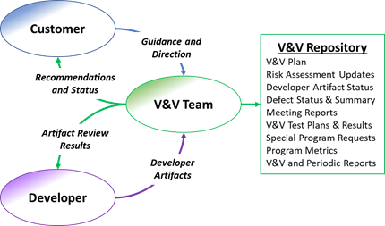
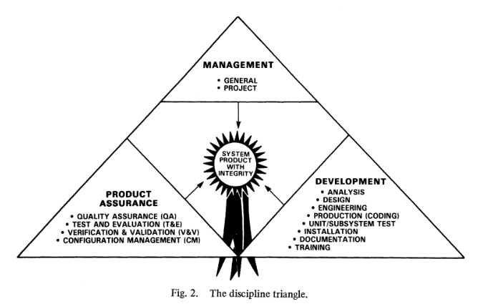

Slide 32
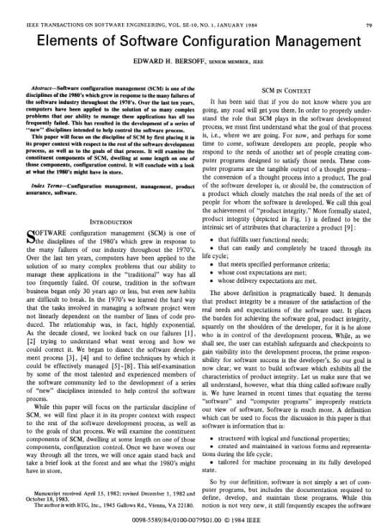
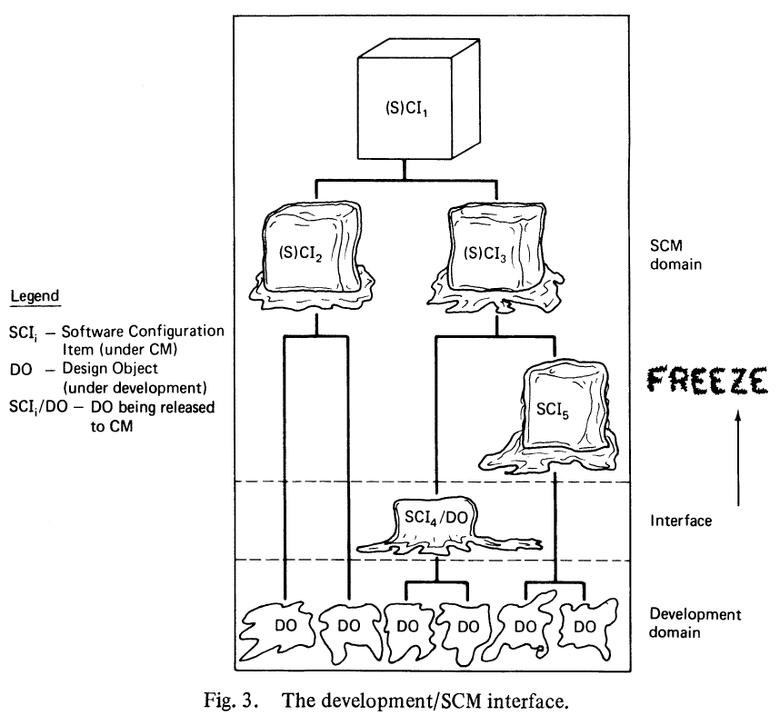
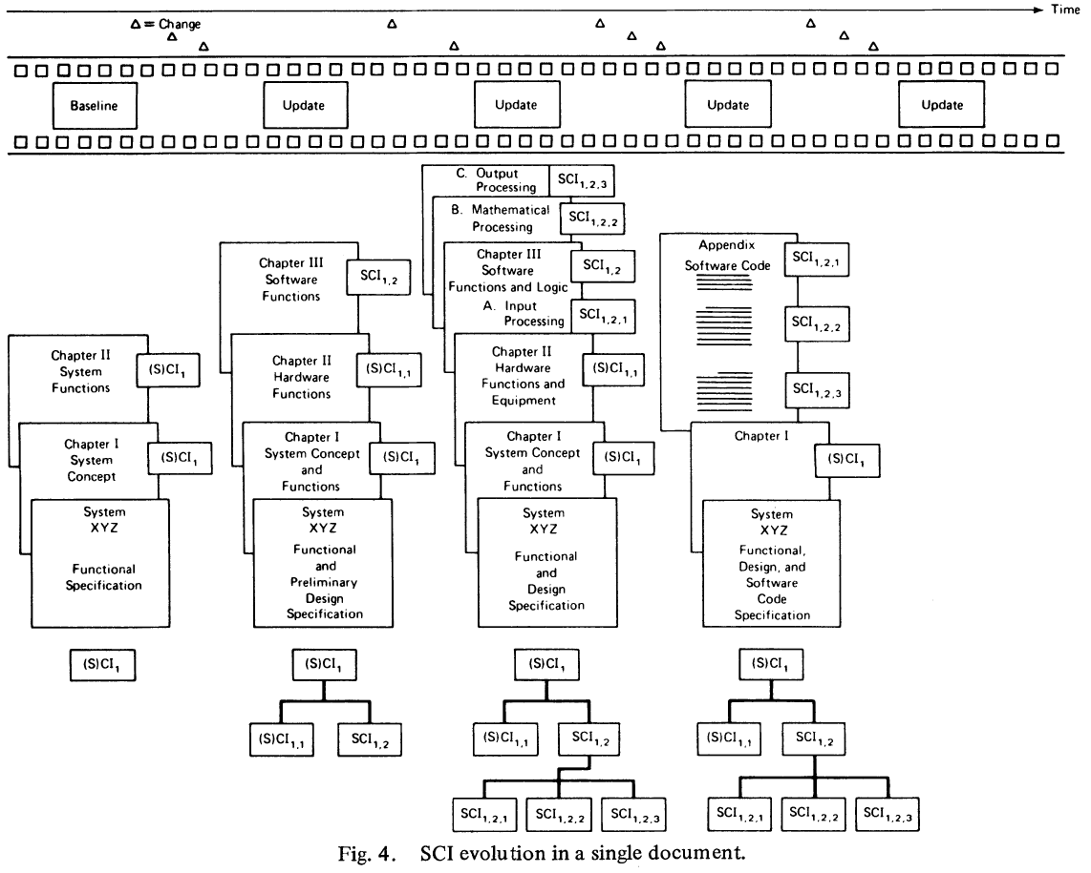
Elements of Software Configuration Management
TLA (Thee letter acronyms) Definitions
SCI, ECP, SCCB, DO, and CCC
SCI - S/W Configuration Item
ECP - Engineering Change Proposal
Request for Change
SCCB - Software Configuration Control Board
PSL – Program Support Libraries (Test Data, SW, etc)
Repositories
https://www.joelonsoftware.com/2000/08/09/the-joel-test-12-steps-to-better-code/
DO - Design Object in Development Domain
Version Control - #, Change cntrl, SW Dev Folder
CCC – Change & Configuration Control Environment p 84 2P.
JIRA – Scrum, Clearcase

Slide 33
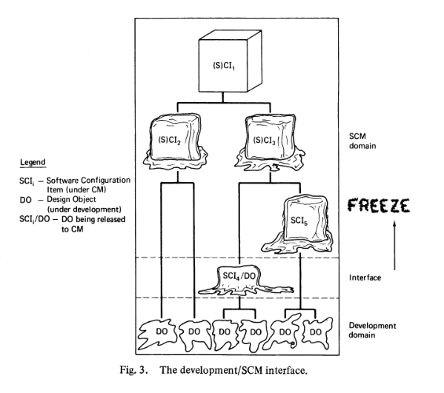

Slide 34
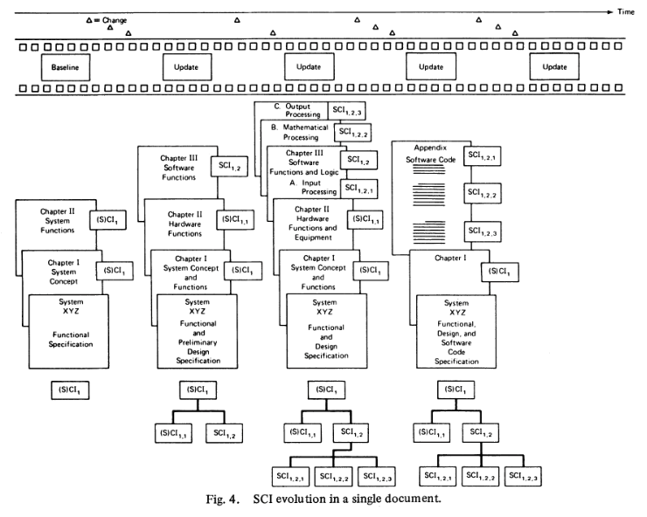

Slide 35
Example of My Experience
ECP
DO
SCI
PSL
CCB
VDD
I think a few stories might help with understanding the reading and the acronyms.
All the projects I have been have had a process of keeping track and managing changes of our software code(SCM). The tools (PSL) changed from project to project but all the code was store in a source control system, either svn, csv, clearcase, GitHub. Each code file, *.cpp, *.java, *.h, configuration files, data files (or call in the reading as SCI) were stored in the source control system.
Whenever a bug was found either from the responsible engineer, testing or from the customer a Deficiency Reports, DRs, was written (ECP) and stored in a bug database. We could even receive requests for new features, that we would turn in to Deficiency Reports, DR (ECP).
Before any could change code or work on the DRs, they had to go through the Configuration Change Board(CCB). This was a group of people that knew the system and tried to identify where the problem was in the code and make sure changes or fixes would not affect the entropy of the system. The DR would be changed into a request to change the software (ECP->DO) and assigned to a Responsible Engineer.
The Responsible Engineer, me or another member of our team would then start collecting information, such as log reports, the original ECP, any previous work, and documentation that might help with solving and fixing the problem, and the requirements & design of the fix. All of this information would go in to a Software Development Folder, SDF (DO).
The status of the task usually is kept in a database (i.e. cleartool) or program (Jira)( also known as a SW Configuration Status Accounting). The code (SCIs) and files that needed to be changed would identified, and documented in the SDF (DO), along with test procedures and data.
All the changes would be then rolled into a delivery and identified in a VDD (Version Description Document)
The author of Stack Overflow, Joel, has a blog that address these fundamental elements of every project, a change process (SCM), code repository (PSL, SCI), Change board (CCB), a bug database (ECP), and a way of recording the history of changes(DO).
https://www.joelonsoftware.com/2000/08/09/the-joel-test-12-steps-to-better-code/

Slide 36
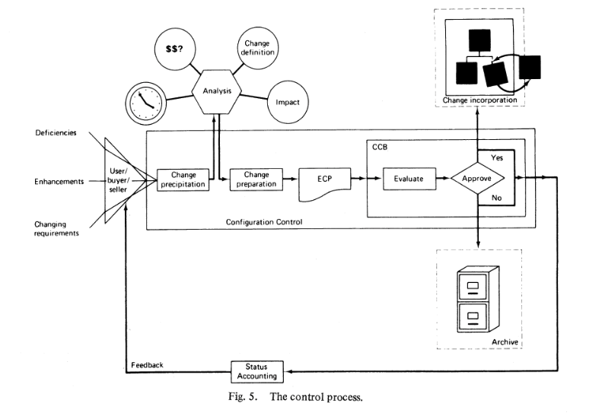
Bug Report
Deficiency
Project Lib
Bug Report
Bug Reports
Project Lib
Project Meetings
Enhancement
CCB
Action Items
Problem Reports
Story or DR or PR
Change Requirement
Responsible Engineer
Review
SW Artifacts
Program Lib
Project Docs
SW Dev Folder
Code Change
Test
Product Lib
Code
Delivery

Slide 37
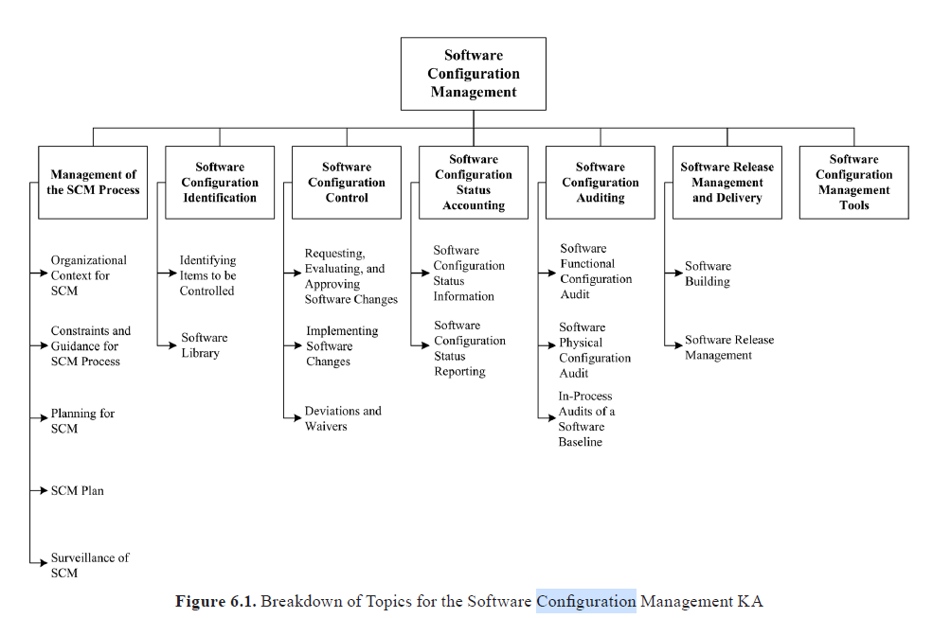
SWEBoK: CHAPTER 6 SOFTWARE CONFIGURATION MANAGEMENT

Slide 38
SWEBOK: SW Config. Mngt.
SCI, ECP, SCCB, DO, and CCC
CCC – Change & Configuration Control Environment
ECP - Engineering Change Proposal
Request for Change
SCCB - Software Configuration Control Board
DO - Design Object
SCI - S/W Configuration Item
PSL – Program Support Libraries
How do these map through the process?

Slide 39
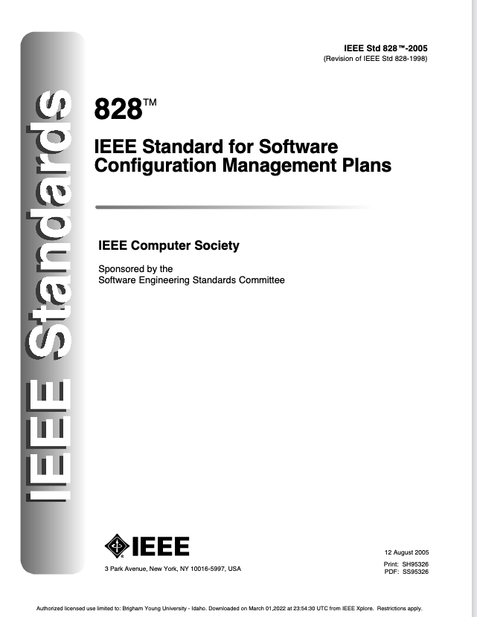
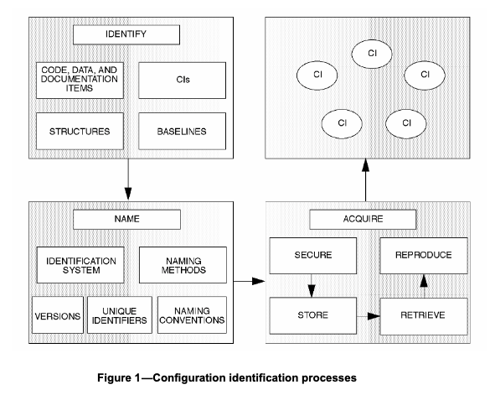
IEEE 828 IEEE Standard for Software Configuration Management Plans
The Software Configuration Management Plan
Introduction
SCM management
Organization
SCM responsibilities
Applicable policies, directives, and procedures
Management of the SCM process
SCM activities
Configuration identification
Identifying configuration items
Naming configuration items
Acquiring configuration items
Configuration control
Requesting changes
Evaluating changes
Approving or disapproving changes
Implementing changes
Configuration status accounting
Configuration evaluation and reviews
Interface control
Subcontractor/vendor control
Release management and delivery
SCM resources
SCM plan maintenance

Slide 40
Certified Software Quality Engineer Handbook, ASQ Quality Press
Westfall, Linda. Certified Software Quality Engineer Handbook, ASQ Quality Press, 2009. ProQuest Ebook Central,
http://ebookcentral.proquest.com/lib/byui/detail.action?docID=3002591.

Slide 41
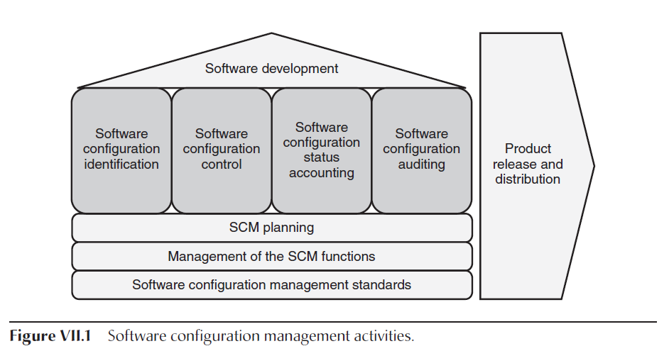
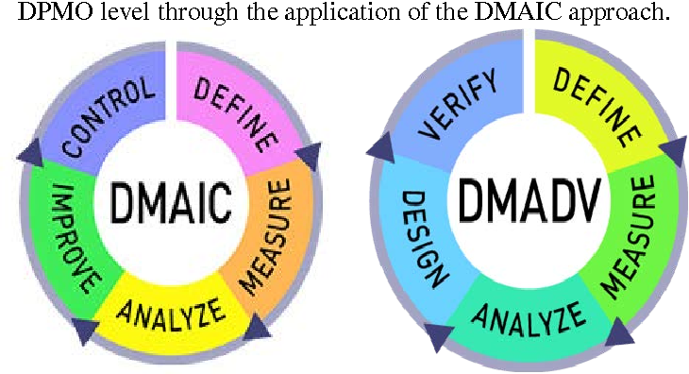
Configuration Management
configuration management
“a discipline applying technical and administrative direction and surveillance to:
identify and document the functional and physical characteristics of a configuration item,
control changes to those characteristics,
record and report change processing and implementation status, and
verify compliance with specified requirements.”
This SCM planning and management function includes:
Establishing and documenting the SCM policies, standards, and processes for the organization
Managing of the SCM functions, including establishing the SCM infrastructure, assigning SCM functional responsibilities, and providing
SCM training
Performing SCM planning for each project, including creating, documenting, and controlling SCM plans as appropriate for the needs of that project
Monitoring the performance of SCM by suppliers
Protecting the intellectual capital of the organization
Establishing SCM metrics to monitor performance and provide input into SCM process improvement
Plan & Design
Execute
Test &Procedure
Revise

Slide 42
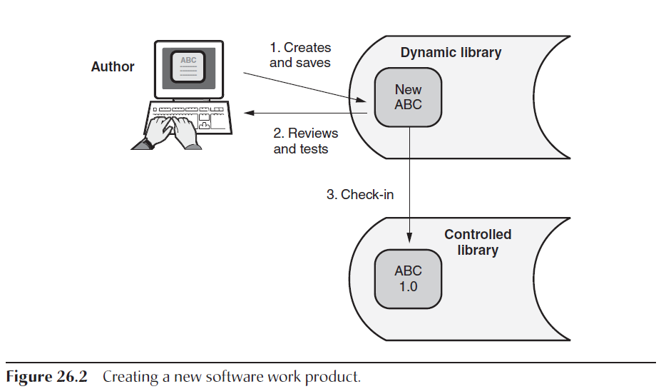
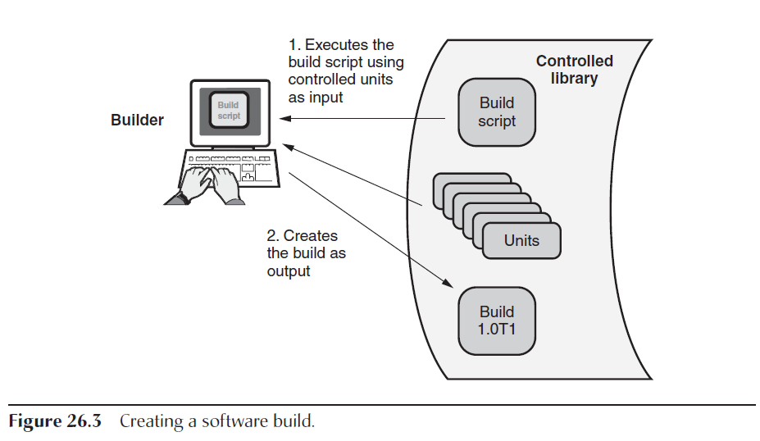
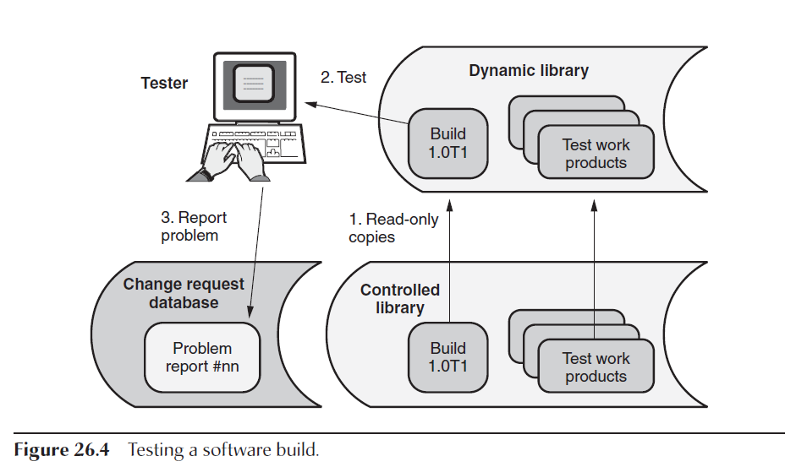
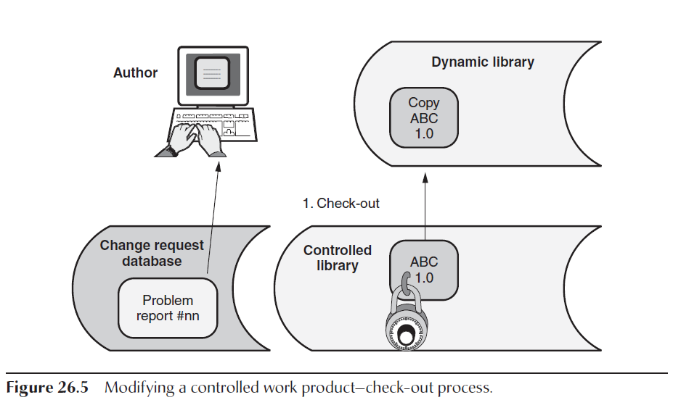
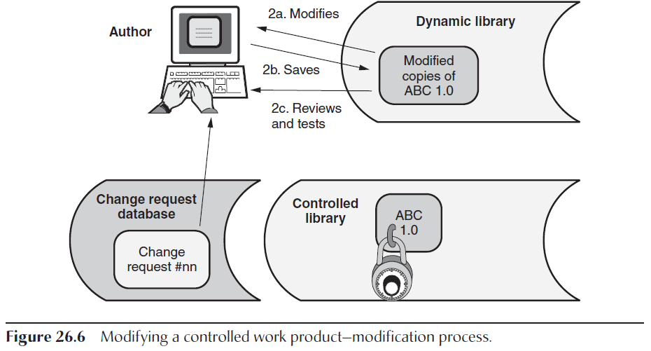
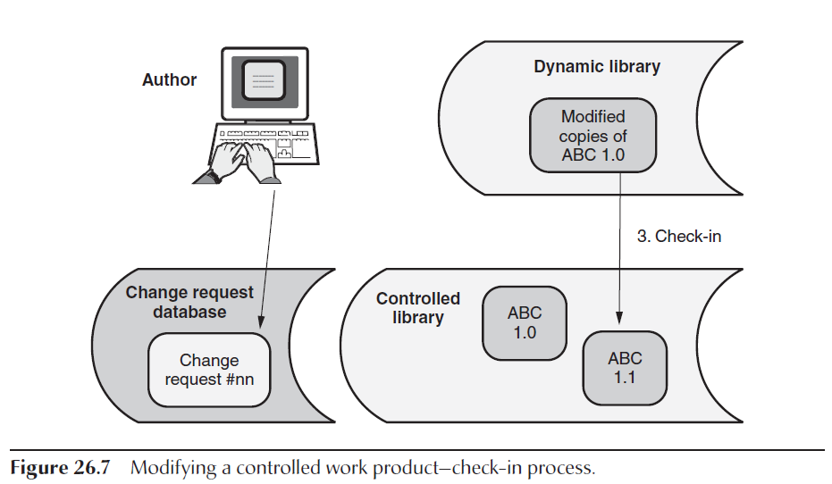
Chapter 26 A. Configuration Infrastructure
1. Configuration Management Team
Organizational-Level SCM Group Roles and Responsibilities
Project-Level SCM Group Roles and Responsibilities
Special SCM Roles and Responsibilities
2. Configuration Management Tools
SCM Library and Version Control Tools
SCM Build Tools
SCM Change Management Tools
SCM Status Accounting Tools
3. Library Process es
Dynamic Library
Controlled Library
Static Library
Backup Library
SCM Library Process: Creating a New Software Work Product
SCM Library Process: Creating a Software Build
SCM Library Process: Testing a Software Build
SCM Library Process: Modifying a Controlled Work Product
SCM Library Process: Branching
SCM Library Process: Merging

Slide 43
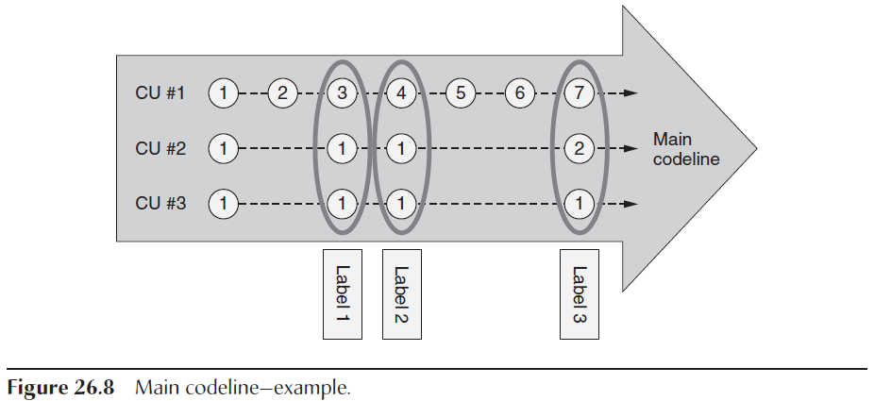
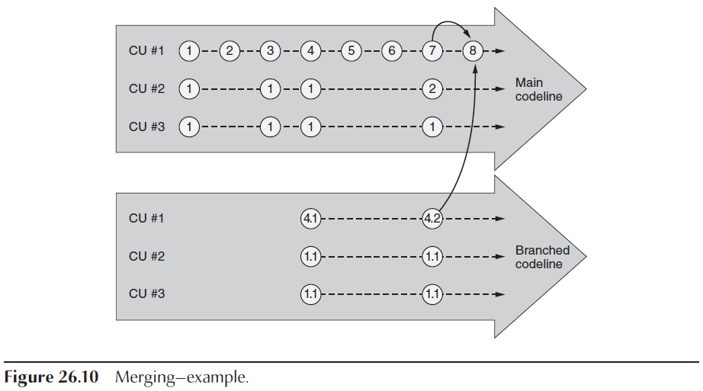
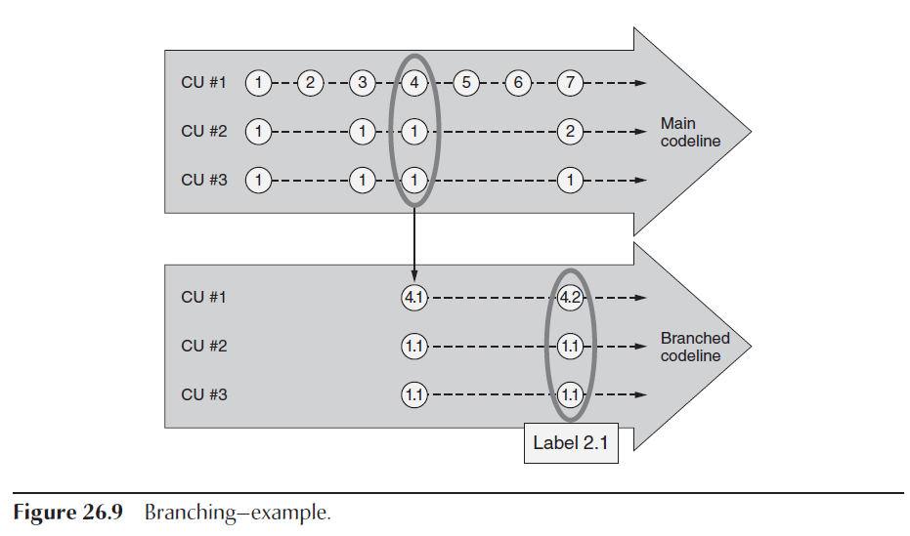
Chapter 26. A. Configuration Infrastructure

Slide 44
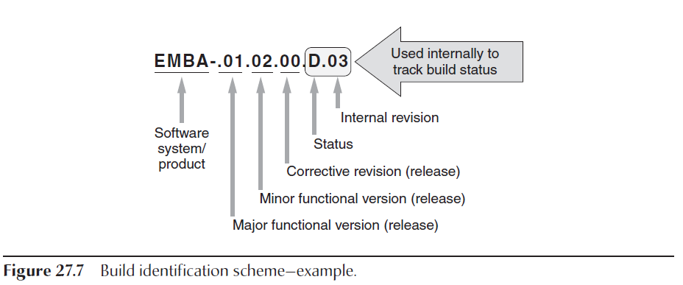
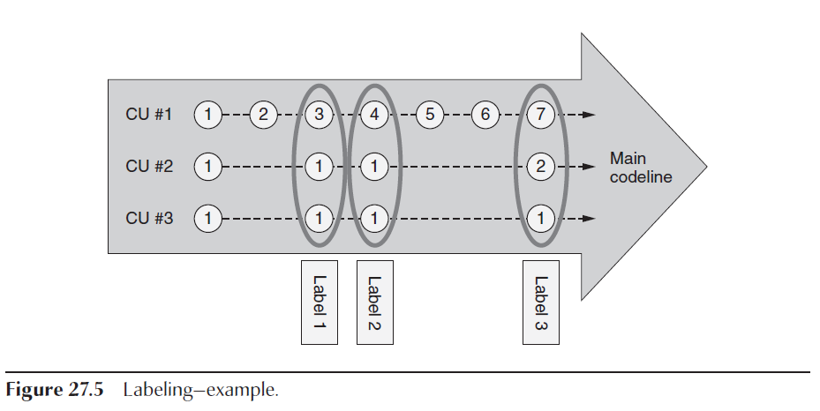
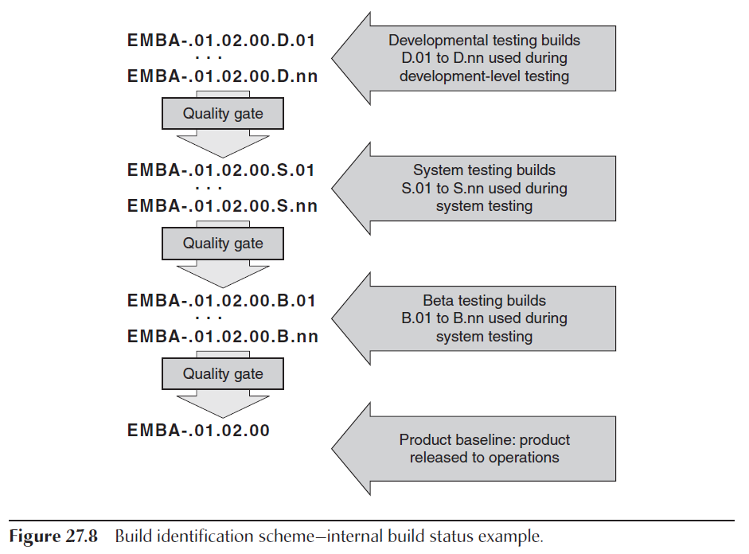
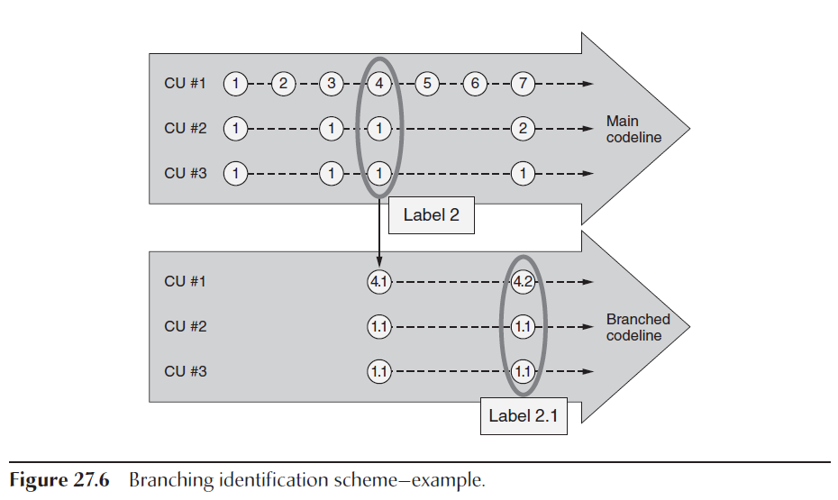
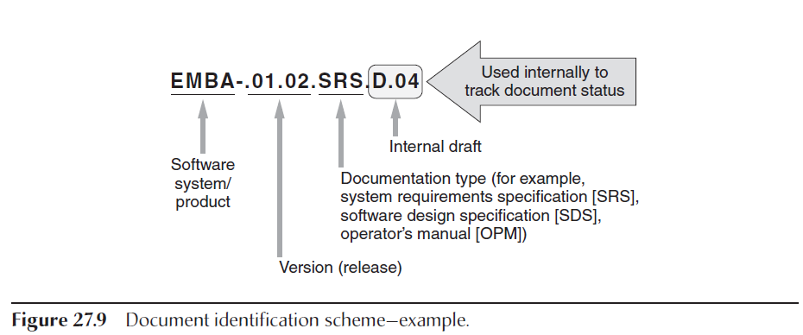
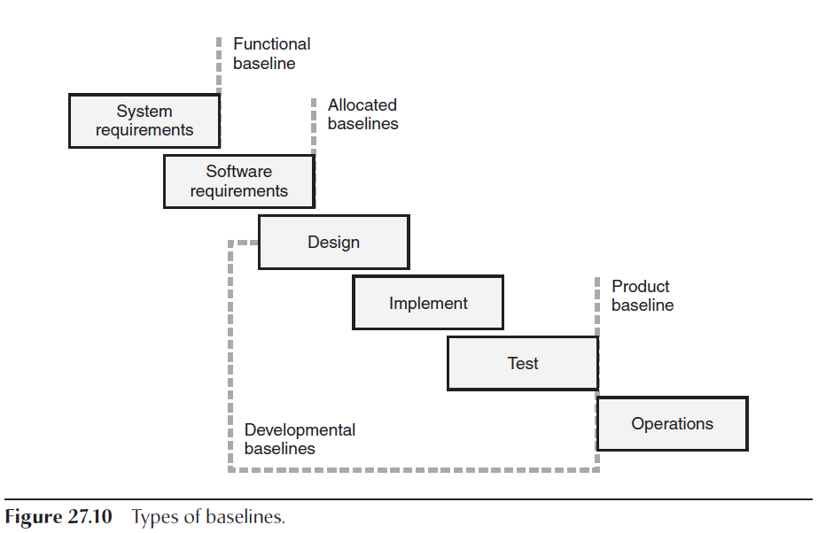
Chapter 27 B. Configuration Identification
1. Configuration Items
Software Product Partitioning
Functional and Physical Characteristics
Acquisition Points
Identification Methods
Baselines
2. Software Builds
Build Automation
Build Reproducibility

Slide 45
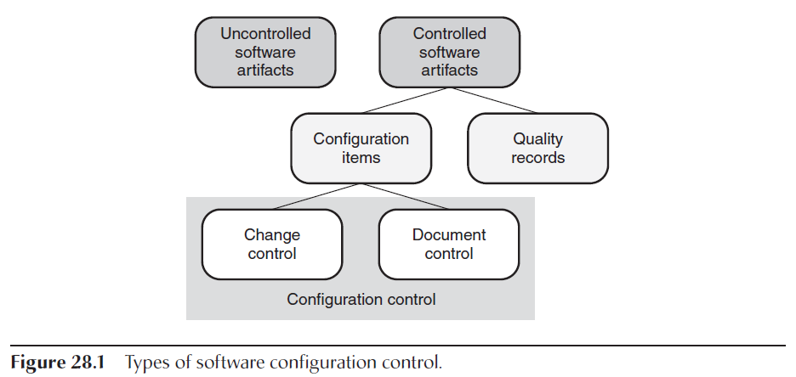
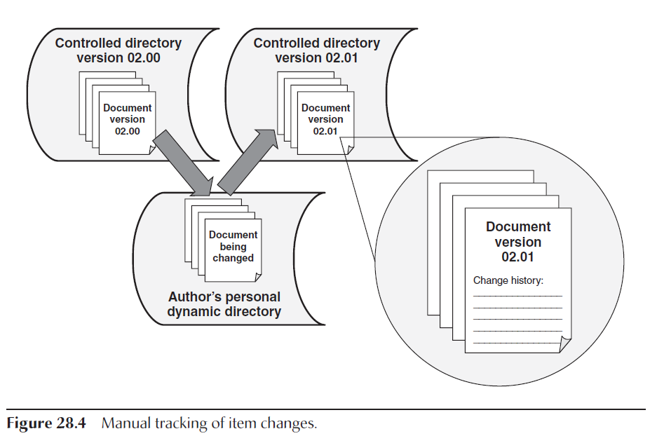
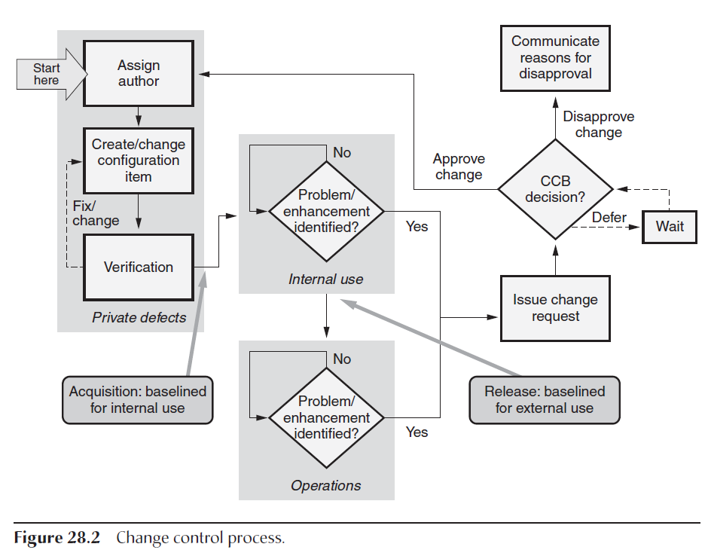
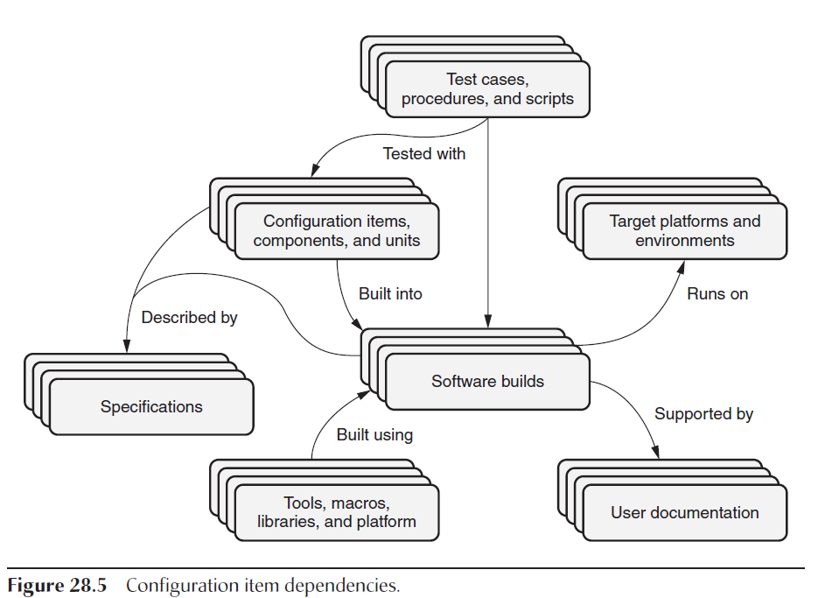
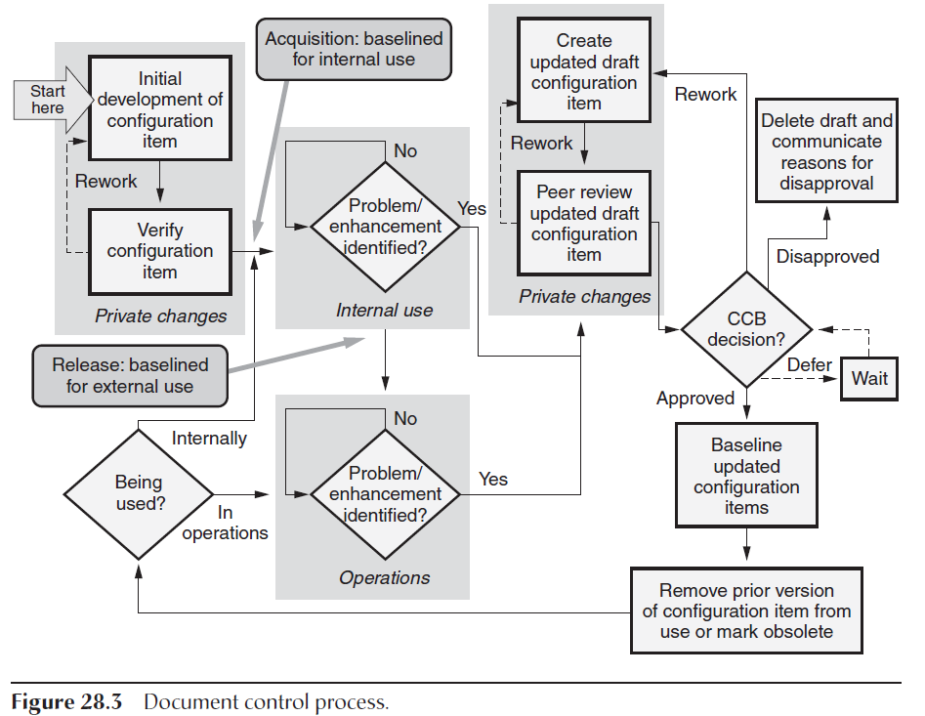
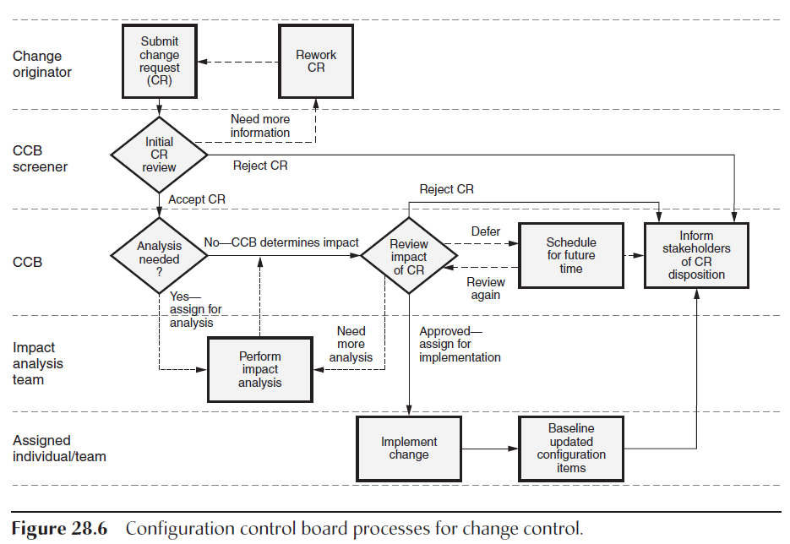
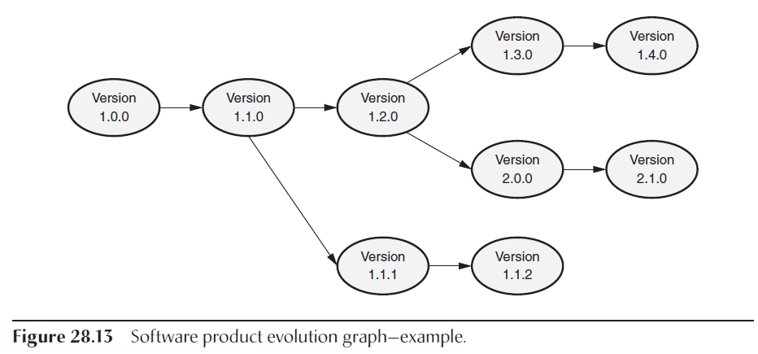
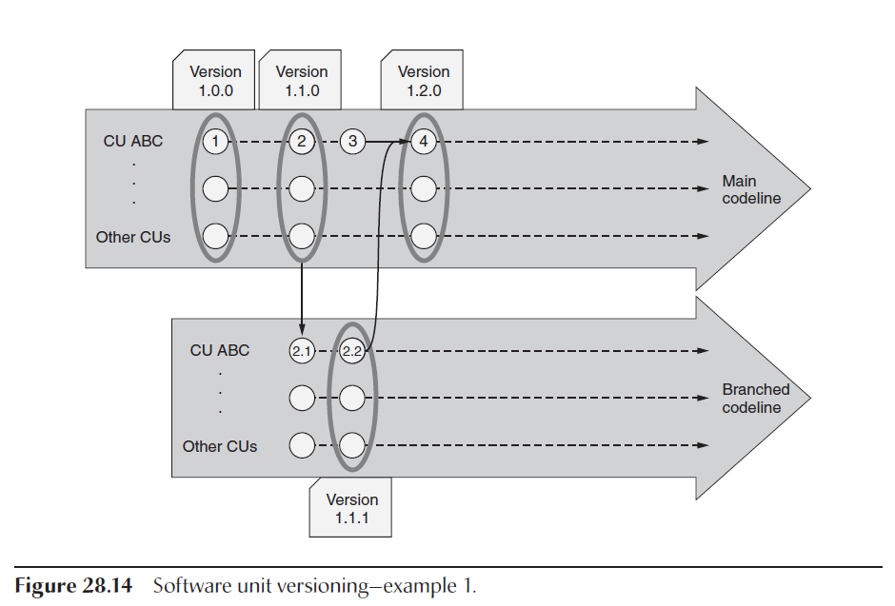
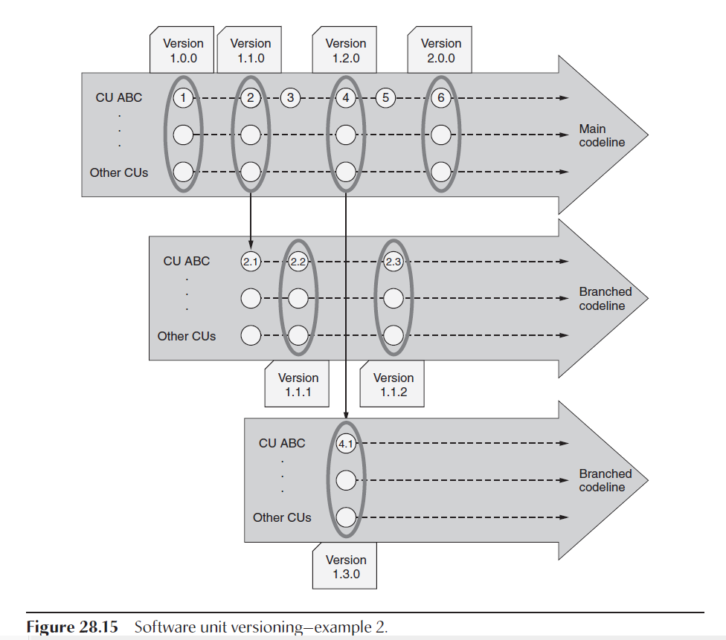
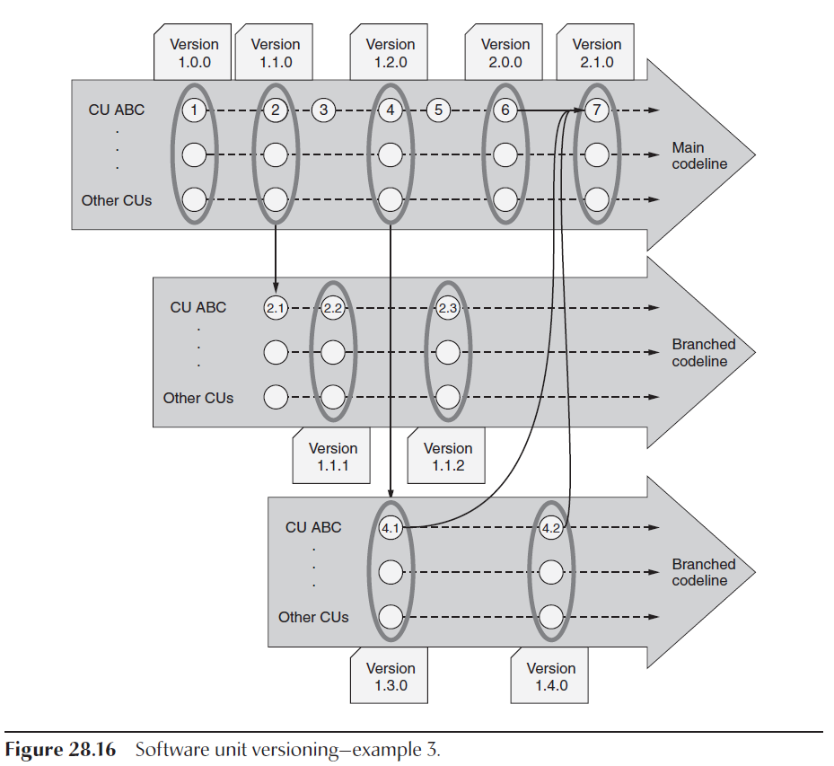
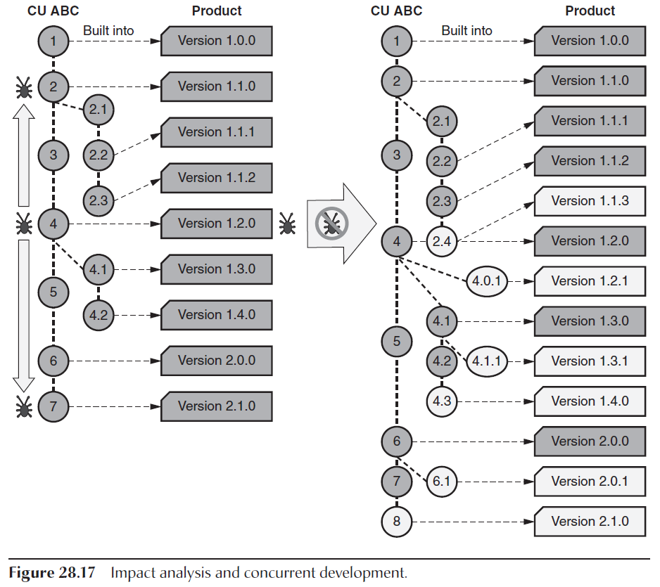
Chapter 28 C. Configuration Control and Status Accounting
1. Item, Baseline, and Version Control
Change Control
Document Control
Tracking Item Changes
Version Control
Configuration Item Dependencies
2. Configuration Control Board (CCB)
CCB Member Roles and Responsibilities
CCB Process: Change Control
CCB Process: Document Control
Impact Analysis
Multiple Levels of CCBs
3. Concurrent Development
4. Status Accounting
Data Collection and Recording
Status Reporting

Slide 46
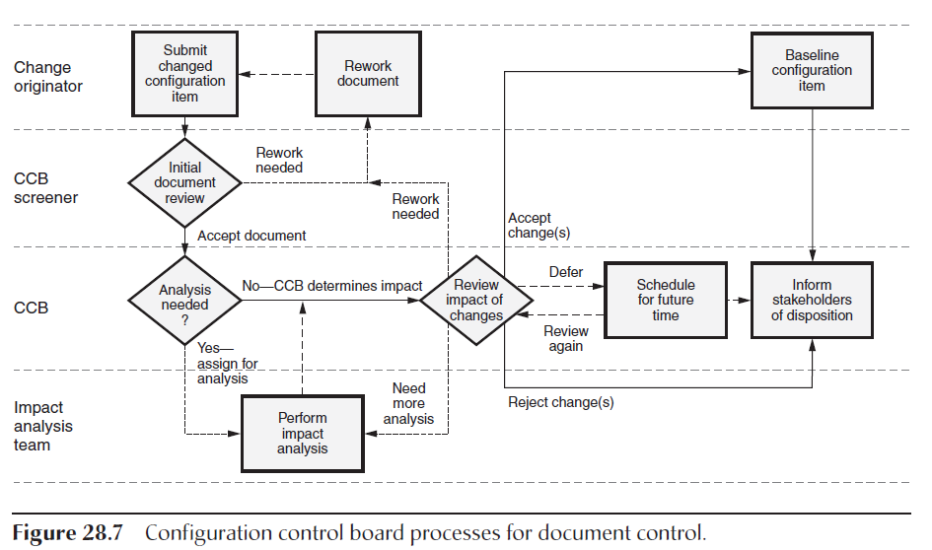
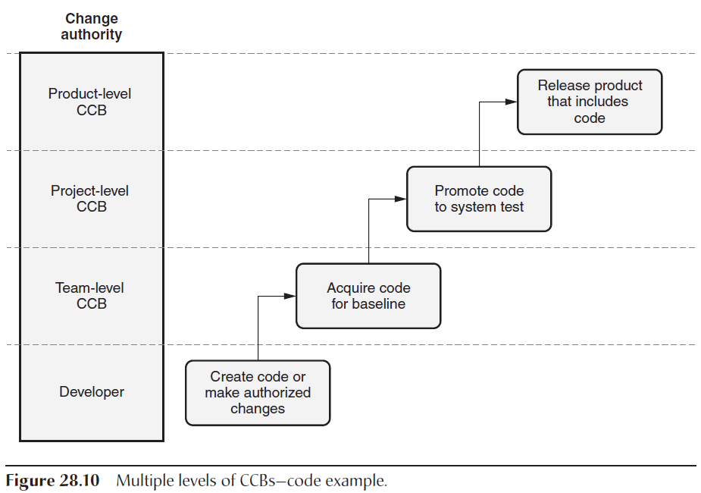
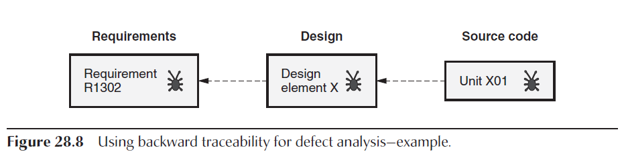



Chapter 28 C. Configuration Control and Status Accounting
1. Item, Baseline, and Version Control
Change Control
Document Control
Tracking Item Changes
Version Control
Configuration Item Dependencies
2. Configuration Control Board (CCB)
CCB Member Roles and Responsibilities
CCB Process: Change Control
CCB Process: Document Control
Impact Analysis
Multiple Levels of CCBs
3. Concurrent Development
4. Status Accounting
Data Collection and Recording
Status Reporting

Slide 47
Chapter 29 D. Configuration Audits
Functional configuration audit (FCA)
Physical configuration audit (PCA).
In-process SCM audits.
IEEE Standard for Software Configuration Management Plans
Functional Configuration Audi t (FCA)
Physical Configuration Audi t (PCA)
Standardized Checklists

Slide 48




Chapter 30 E. Product Release and Distribution
1. Product Release
Types of Releases
Release Planning and Scheduling
Version Description Documentation
Release Packaging
Replication, Delivery, and Installation
Hardware and Software Dependencies
Release Support
2. Archival Processes
Backups
Quality Records

Slide 49
SVN

Slide 50



Slide 51

Version Control (of one file)
Base
Integration
ACID – Atomic, Consistent, Isolated, Durable
CRUD – Create, Read, Update, Delete
1st Change and Commit
2nd Update, merge, commit
3rd merge, commit
Version 2.2
Version 2.2
Version 2.1
Add. Layer
Version
Dev (DR#)
n
Version 2.2
Version
Dev (DR#)
N+1?
Should update anyways
Commit
Update
Merge
commit
change
commit
change
commit
change
Commit
Can’t track chage to DR#
change
commit
n
Update
Merge
commit
N+1
no change & commit
Only update, merge, commit

Slide 52
Version Control (of one file)
Base
Baseline 1
Version 2.x
Version 2.2
Version 2.1
Add. Layer
Version
Dev (DR#)
n
Baseline 2
DR Merge
Version 2.2
n
n
N+1
Version
Dev (DR#)
N+1
N+1?
Should update anyways
Commit
n
change
commit
Update
Merge
commit
N+1
change
commit
change
Commit
Can’t track change to DR#
change
commit
n
2 Baselines causes a cascading update and merge – big deal
Typically a DR
N+1
Update
Merge
commit
N+1
no change & commit
Only update, merge, commit

Slide 53
SCM Tool Recommendations
Defect Tracking System
(ClearQuest, Rally, Trac, Jira)
Provides all change details
Used for Release Planning and Scheduling of Software Builds
Software Release Notes are generated directly from the defect tracking system
Version Control System
(ClearCase, git, Subversion)
Code is checked into this system
Ensures integrity of codebase
Requires ticket authorization
Potentially inspects code (style guide enforcement, static code analysis, license compliance, etc.) prior to check-in.
Peer Review System
(SmartBear CodeCollaborator)
Code changes are reviewed online before being incorporated into baseline
Code is re-worked and re-reviewed cyclically until it is approved
Static Code Analysis System
(Coverity, Parasoft, Cobertura, Fortify, Findbugs, SonarCube)
Automated tools analyze code for bugs
Ensures License compliance in code headers (MIT, GPL, etc.)
Compile / Build System
(Jenkins)
Automated tools compile and package code into deliverables
Automatically performs unit tests as part of compile process
Historical build results are available for review
Automated Test System
(Jenkins)
Compiled code is regression tested thru automated tools
Ideally, these tests will be linked to Program/System requirements
Automated tools ensure compliance with NGC Coding Style guides

Slide 54
Additional SCM Activities
Additional SCM Activities
Build Management
Managing the process and tools used to build software
Process Management
Ensuring that the change and development process is defined and followed
Environment Management
Managing the development and test environment that hosts the system in collaboration with program IT services
Teamwork
Facilitating team interactions related to the process
Notes:
The Key Elements of Configuration Management are:
Configuration Management Planning and Management – Documents how CM will be implemented (including work instructions) on the program.
Configuration Identification – What do we want to control and at what level?
Change Management – How are changes controlled: authorized, worked and tracked?
Status Accounting – How are changed documented?
Verification and Audits – How is conformance to the baseline verified?
The CMP is the CM requirements for the program (what to do)
The CM procedures implement the CM requirements (how to do it)
We will cover each element in detail.

Slide 55
Tasks of Configuration Managers
What is the difference between
IT Manager,
Security Manager,
Data Manager,
Configuration Manager,
Quality Manager?
Sample Documentation Types
SCMP following the IEEE 828-1990 standard
Define configuration items
Unique id, version, date
3rd Party S/W, Licenses
Define promote /release policies
Define activities and responsibilities
Set up configuration management system
Configuragion Management of Documents, Data, SW code, Tests, Exec Config Files, Env Config, Licensing, Defects, SDF, etc
Specification
* SW Config
* System
* Development
* Prime Item
* Critical Item
* Complex Item
* Non-Complex
* Software Items
* Product
* Process
* Material
Drawings/Lists
* Engineering Document
* Digital Data File
* Specification Tree
* Drawing Tree
Other
* Non-Govt Standards
* ISO
* Commercial Item Descriptions

Slide 56
CASE STUDIES
Relate the principles taught in the article to your proposed solution. This includes identification of SCI, ECP, SCCB, DO, and CCC.
SCI - S/W Configuration Item
ECP - Engineering Change Proposal
SCCB - Software Configuration Control Board
PSL – Program Support Libraries (Test Data, SW, etc)
DO - Design Object in Development Domain
CCC – Change & Configuration Control Environment
Other Issues:
Bad merge
Hit by a bus, quits, sick – disappears
Loss of code
Lack of SCM
Lack of Knowledge – scope, domain
Bad implementation
Fixing someone else mistake
Duplicate work

Slide 57

Case Study 1 – Design and Code Mismatch
A development team has spent 2 months writing code based on a design description that is baselined in their Version Control System.
Unfortunately, unbeknownst to the developers, there are multiple outstanding approved Change Requests (CRs) against the design description.
When the CRs are finally implemented in the design, the design becomes substantially different. It does not match the newly developed source code and 10,000 lines of code must be reworked.
How could this have been avoided?

Slide 58

Case Study 1 – Design and Code Mismatch Example Solutions
Documentation should be baselined and configured in a Version Control System. Any changes written against the baselined document should be reflected in a document CR.
When a document CR is presented at the SCCB, applicable stakeholders should be present, understand the impact of the changes, and relay the information to those that need to know.
SCCB minutes should be generated and distributed after each SCCB. Team members should review the minutes to become aware of the approved changes, especially if they were not present at the SCCB. Attendance at the meeting should be recorded.
Design changes should not lag. Design changes should be scheduled to be worked in a timely manner.
A process should be put in place to review outstanding CRs against the design before development begins – make the configuration status of the design known to the developers.

Slide 59

Case Study 2 – Parallel Development
Scenario:
Program X has a well documented and well tested production baseline that has been delivered to the customer. It is stored in the Version Control System and labeled REL_1.0. The customer is so happy with their new product that they have paid for 3 enhancements. The only negative is that the customer wants the enhancements delivered in 3 weeks.
How should the software development be organized so that this schedule can be met?
Software management has decided to assemble 3 teams to implement each enhancement. How can the teams work efficiently and not “step on” each other?
Team 1 and team 2 are finishing their efforts faster than team 3. They want to integrate their changes together. What are the strategies for making this happen?
Team 3 is finally finished (their enhancement was more difficult). How should they join team 1 and team 2’s integration effort?
Team 3’s enhancement is not functioning per customer requirements. The customer and management have decided that the 3rd enhancement is not necessary for the next release and can be delivered at a later time.
What is the easiest way to baseline the software and deliver to the customer?

Slide 60

Case Study 2 – Parallel Development Example Solution
Software management has decided to assemble 3 teams to implement each enhancement. How can the teams work efficiently and not “step on” each other?
Each team can work on their own “enhancement” branch off the delivered baseline. When they check in or commit their changes, the rest of their team will immediately see the changes in their own environment (segregated on their own branch).
Team 1 and team 2 are finishing their efforts faster than team 3. They want to integrate their changes together. What are the strategies for making this happen?
Team 1 and team 2 create a new “combine” branch and merge their “enhancement” branches together. They use this independent branch to perform integration and testing. If the teams change the same file, the version control tool should handle the merge conflicts and prompt the user for the correct change. Sometimes this requires rework, which can be done on the “combine” branch.

Slide 61

Case Study 2 – Parallel Development Example Solution
Team 3 is finally finished (their enhancement was more difficult). How should they join team 1 and team 2’s integration effort?
First, the state of the “combine” branch should be labeled to mark where the team 1 and team 2 integration completed. Then team 3 should merge their “enhancement” branch into the “combine” branch to perform additional integration and testing. Merge conflicts should be resolved with input from all 3 teams. Rework may be required and can be done on the “combine” branch.
OR
Team 3 creates another “combine” branch – call it “combine_all_3”. Team 3 merges the “combine” branch and their “enhancement” branch into the “combine_all_3” branch. They use this independent branch to perform integration and testing of all 3 enhancements. If the teams change the same file, the version control tool should handle the merge conflicts and prompt the user for the correct change. Sometimes this requires rework, which can be done on the “combine_all_3” branch. The advantage of this strategy is that if the “combine_all_3” branch breaks, if can be destroyed and recreated easily. All the working enhancements are still on the “enhancement” branches and the initial “combine” branch.

Slide 62

Case Study 2 – Parallel Development Example Solution
Team 3’s enhancement is not functioning per customer requirements. The customer and management have decided that the 3rd enhancement is not necessary for the next release and can be delivered at a later time. What is the easiest way to baseline the 2 enhancements for delivery to the customer?
In step 3, if you used the first solution, then merge from the labeled version on the “combine” branch to the baseline branch and deliver. If you used the second solution, “combine_all_3” branch can be destroyed and “combine” branch is merged to the baseline branch and delivered. Team 3 goes back to their “enhancement” branch to continue development.

Slide 63

Case Study 3 - Modifying Product Line Software
Software product lines (COTS, GOTS, BOTS, POTS) are related applications developed around a common core of shared functionality. It is a common practice for programs to propose the use of product line implementation to lower costs, increase software development and lower risks.
Of course, the product line implementation of software rarely meets all of the program requirements, so the product line may need to be modified. Making program specific changes to a delivered product line presents software configuration management challenges as the software is enhanced throughout the lifecycle of the program.
Scenario:
Program A is required to use the latest release of the Enterprise product line. The Enterprise releases new product baselines, which include bug fixes and new functionality, at regular intervals.
Program A also has additional program specific Mobil Manager requirements
that need to be implemented.
What are the SCM strategies for configuring product lines, making program specific
enhancements, and upgrading product line releases on a regular basis?
How would check in the code for each of these two changes on the same code file
without causing conflicts?

Slide 64
Case Study 3 – Modifying Product Line Software
Example Solution
SCM: All source control software has merge issues. Auto merge is extremely dangerous. What steps should be taken each time a merge is done to reduce the risk?
Run before anything else
Pull before push
Run after pull
Push
Pull after push and run
main
product_import
1
PROD_2.3
program_baseline
merge
2
PROD_2.6
REL_P2.3_0.0
1
cr-00002
merge
cr-00001
1
Run tests
REL_P2.3_1.0
2
Change Request # | Description | Type
cr-00001 | Add program specific function x | new_function
cr-00002 | Upgrade to product baseline version 2.6 | synchronization
Run tests
1
merge
2
REL_P2.6_1.0
3
2
Run tests
Run tests
rebase
merge

Slide 65

Case Study 3 – Modifying Product Line Software Example Solution
SCM imports the product release 2.3 onto an “product_import” branch and labels PROD_2.3.
SCM merges the PROD_2.3 baseline to the “program_baseline” branch and labels REL_P2.3_0.0. This label indicates that this program baseline is derived from release 2.3 of the product baseline.
At this point, it is a good idea to build and test REL_P2.3_0.0 to make sure that the product line baseline functions as expected.
The first change request, cr-00001: Add program function x, is created and approved by the SCCB.
A developer will create branch “cr-00001” from REL_P2.3_0.0, implement the change request, and test.
The changes on “cr-00001” are merged back into the next baseline and labeled REL_P2.3_1.0. This label describes release 1.0 of the program baseline derived from release 2.3 of the product baseline.
Meanwhile, another release of the product line becomes available. SCM imports the new baseline onto the “product_import” branch and labels PROD_2.6. Release 2.6 will include all changes since release 2.3. It is important that an SVD accompanies the release. At a minimum, the SVD should include the list of change requests that were incorporated and a list of known issues.
SCM opens a change request , cr-00002: Upgrade to product baseline version 2.6. The CR is reviewed and approved at SCCB.
SCM merges the PROD_2.6 baseline onto the “cr-00002” branch. IMPORTANT NOTE: “cr-00002” is branched from REL_P2.3_0.0, not REL_P2.3_1.0 in order to ensure there are no merge conflicts.
SCM then hands over cr-00002 to a developer. The developer will rebase “cr-00002” with the latest REL_P2.3_1.0 baseline. This will synchronize the latest program baseline with the new product baseline. The source code is built and tested. When all tests pass, the developer notifies SCM to create a new program baseline.
SCM will make a new baseline release on the “program_baseline” branch and label it REL_P2.6_1.0.
NOTE: It is BEST to only include the one synchronization SCR in the new baseline. If you combine the sync CR with additional program specific CRs and the software does not function, you will not be sure if the issue is with the upgraded product baseline or the new program functionality.

Slide 66

Some Questions every project to ask?
Is a change control process defined, documented and enforced on your program?
What defect tracking tools are used on your program? List the Pros and Cons.
What version control tools are used on your program? List the Pros and Cons.
Do you have a dedicated SCM assigned to the program? Are they an integral part of your engineering team?
If an SCM is assigned to your program, were they involved in the planning phases, and are they an integral part of your day-to-day engineering effort? Or, are they brought in to assist when deliveries occur? If the latter, what are the advantages and disadvantages?
Does your program hold SCCBs? How are they structured? Do you find them valuable? If not, why and what could be improved?
Are all the components of your system configured? If required, could you produce all the pieces to build your software in a repeatable fashion?

